Slide 1
Credit EDA Case Study
By Rishabh Tiwari

Slide 2
Agenda
Mention the problem statement.
Present the overall approach of the analysis.
Conclusion

Slide 3
Problem Statement
Present the overall approach of the analysis in a presentation. Mention the problem statement and the analysis approach briefly.
Identify the missing data and use an appropriate method to deal with it. (Remove columns/or replace them with an appropriate value)
Identify if there are outliers in the dataset. Also, mention why you think it is an outlier. Again, remember that for this exercise, it is not necessary to remove any data points.
Identify if there is a data imbalance in the data. Find the ratio of data imbalance.
Explain the results of univariate, segmented univariate, bivariate analysis, etc. in business terms.
Include visualizations and summarize the most important results in the presentation.

Slide 4
Overall Approach
Reading and Understanding the data
Univariate Analysis for Categories
Correlation
Univariate Analysis for Variables
Bivariate Analysis for Numerical Variables
Conclusion

Slide 5
Categorical Univariate Analysis for Target 0

Slide 6
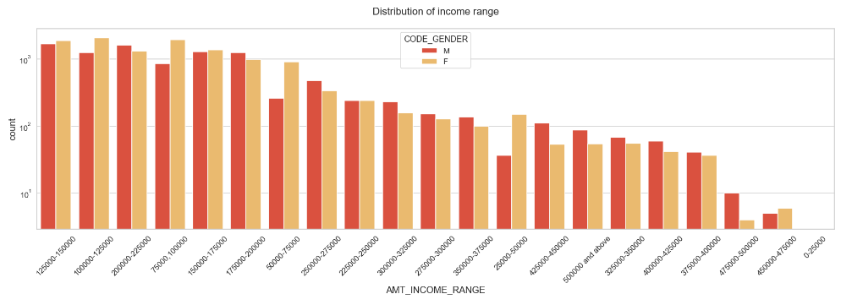
Distribution of Income Range

Slide 7
Points to be concluded from the graph:
Female counts are higher than male.
Income range from 100000 to 200000 is having more credits.
This graph shows that females are more than males in having credits for that range.
Very less count for income range 400000 and above.

Slide 8
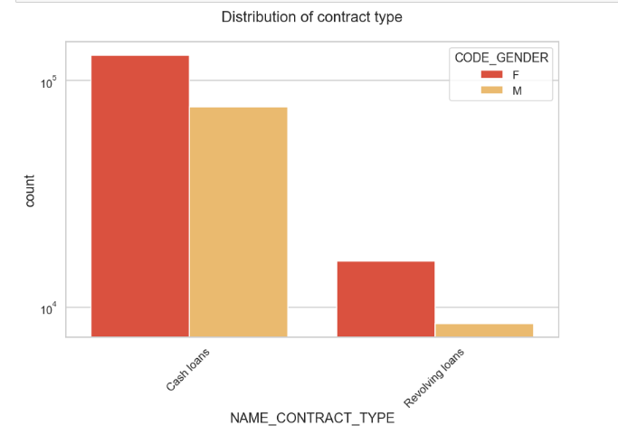
Distribution of Contract Type

Slide 9
Points to be concluded from the graph:
For contract type ‘cash loans’ is having a higher number of credits than the ‘Revolving loans’ contract type.
For this also Female is leading in applying for credits.

Slide 10
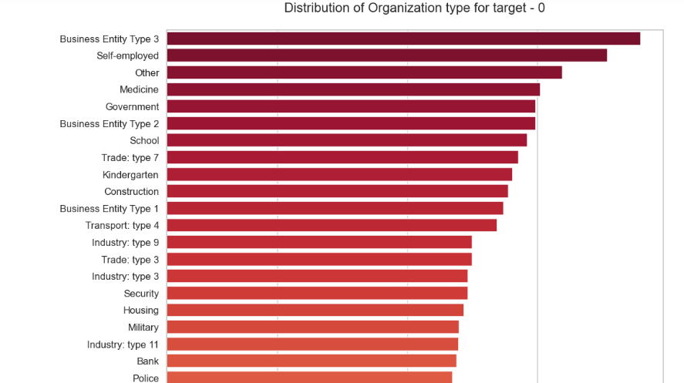
Distribution of Organization Type

Slide 11
Points to be concluded from the graph:
Clients which have applied for credits are from most of the organization type ‘Business entity Type 3’, ‘Self-employed’, ‘Other’, ‘Medicine’, and ‘Government’.
Fewer clients are from Industry type 8, type 6, type 10, religion and trade type 5, and type 4.

Slide 12
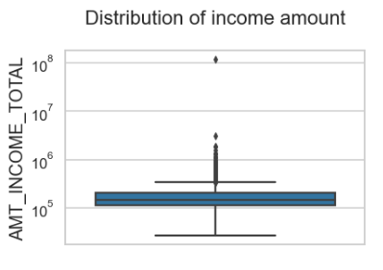
Boxplot for Income Amount

Slide 13
Points to be concluded from the graph:
Some outliers are noticed in income amounts.
The third quartile is very slim for income amount.

Slide 14
Categorical Univariate Analysis for Target 1

Slide 15
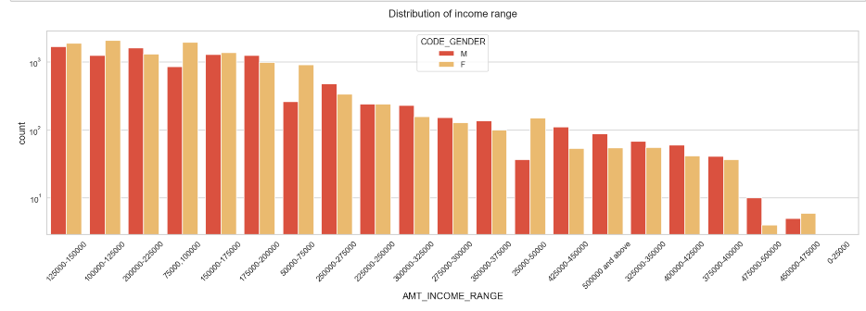
Distribution of Income Range

Slide 16
Points to be concluded from the graph:
Male counts are higher than female.
Income range from 100000 to 200000 is having more credits.
This graph shows that males are more than female in having credits for that range.
Very less count for income range 400000 and above.

Slide 17
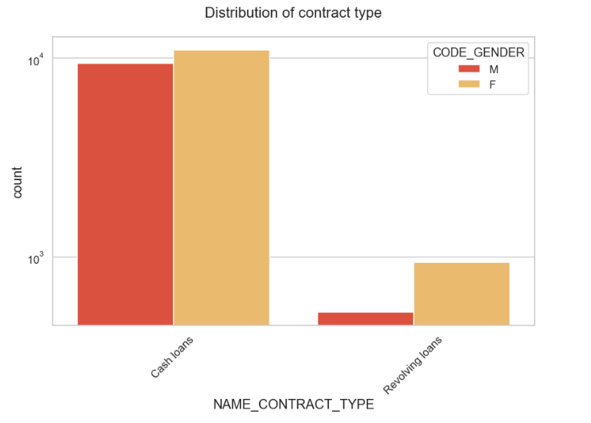
Distribution of Contract Type

Slide 18
Points to be concluded from the graph:
For contract type ‘cash loans’ is having a higher number of credits than the ‘Revolving loans’ contract type.
For this also Female leading in applying for credits.
For type 1: there are only Female Revolving loans.

Slide 19
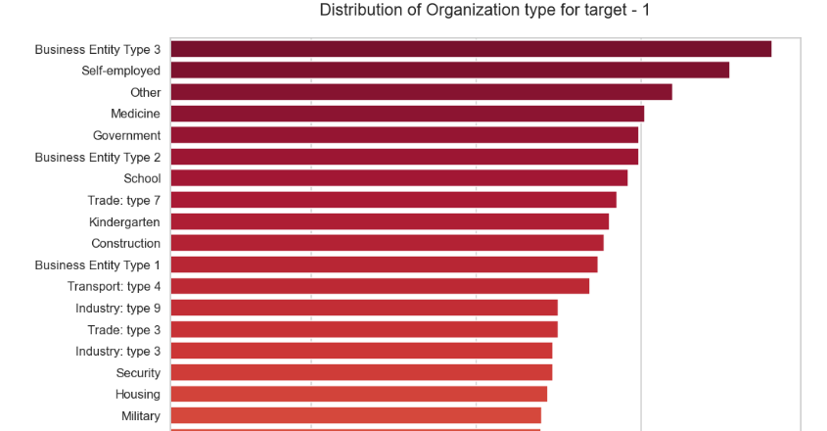
Distribution of Organization Type

Slide 20
Points to be concluded from the graph:
Clients who have applied for credits are from most organization type ‘Business entity Type 3’, ‘Self-employed’, ‘Other’, ‘Medicine’, and ‘Government’.
Fewer clients are from Industry type 8, type 6, type 10, religion and trade type 5, and type 4.
Same as type 0 in the distribution of organization type

Slide 21
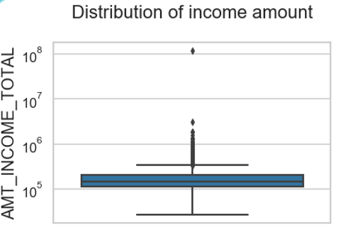
Boxplot for Income Amount

Slide 22
Points to be concluded from the graph:
Some outliers are noticed in income amounts.
The third quartile is very slim for income amount.
Most of the clients of income are present in the first quartile.

Slide 23
Correlation of Target 0

Slide 24
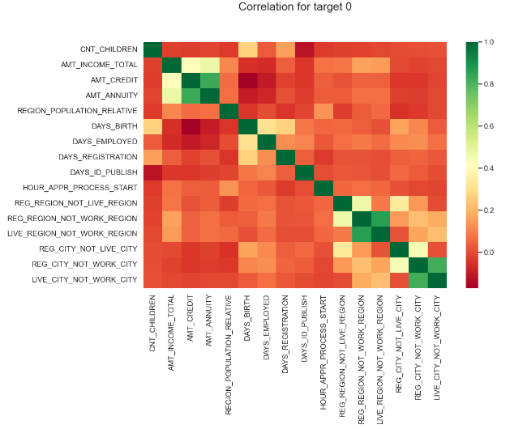

Slide 25
Points to be concluded from the graph:
Credit amount is inversely proportional to the date of birth, which means Credit amount is higher for low age and vice-versa.
Credit amount is inversely proportional to the number of children clients have, which means Credit amount is higher for fewer children count the client has and vice-versa.
Income amount is inversely proportional to the number of children clients have, which means more income for fewer children clients have and vice-versa.
Fewer children clients have in densely populated areas.
Credit amount is higher in a densely populated area.
The income is also higher in densely populated areas.

Slide 26
Correlation of Target 1

Slide 27
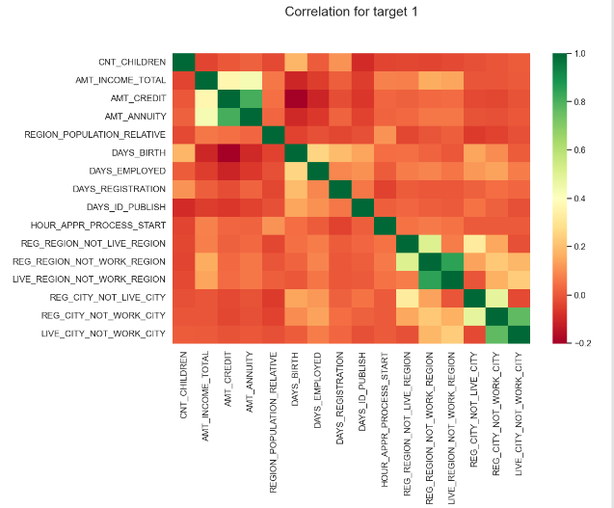

Slide 28
Points to be concluded from the graph:
The client's permanent address does not match the contact address are having fewer children and vice-versa
The client’s permanent address does not match the work address are has fewer children and vice-versa

Slide 29
Bivariate Analysis for Type 0

Slide 30
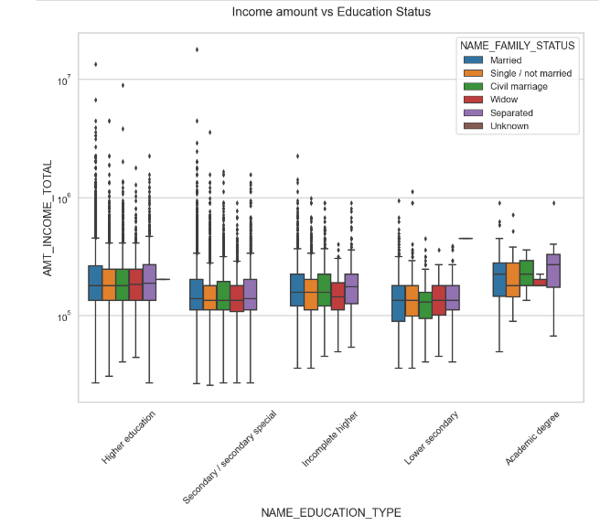
Income Amount vs Education Status

Slide 31
Points to be concluded from the graph:
For the Education type 'Higher education' the income amount mean is mostly equal with family status. It does contain many outliers.
Fewer outliers is having for Academic degree but they are having an income amount is a little higher than Higher education.
Lower secondary of civil marriage family status have less income amount than others.

Slide 32
Bivariate Analysis for Type 1

Slide 33
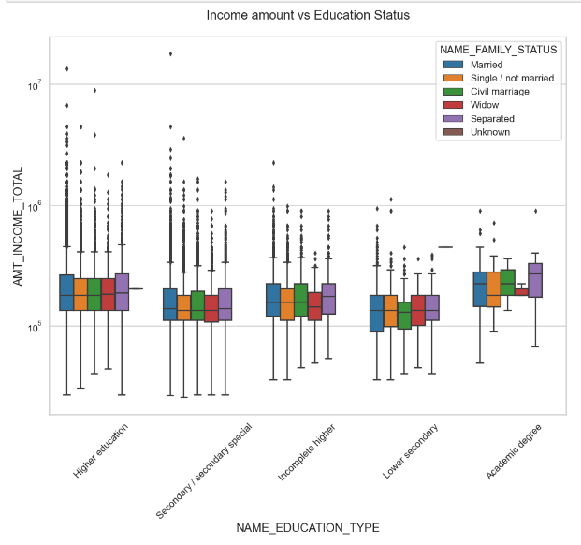
Income Amount vs Education Status

Slide 34
Points to be concluded from the graph:
Have some similarity with Target 0, From the above boxplot for Education type 'Higher education' the income amount is mostly equal with family status.
Fewer outliers are having Academic degrees but their income amount is a little higher than Higher education.
Lower secondary are have less income amount than others.

Slide 35
Univariate Analysis after merging Previous Data

Slide 36
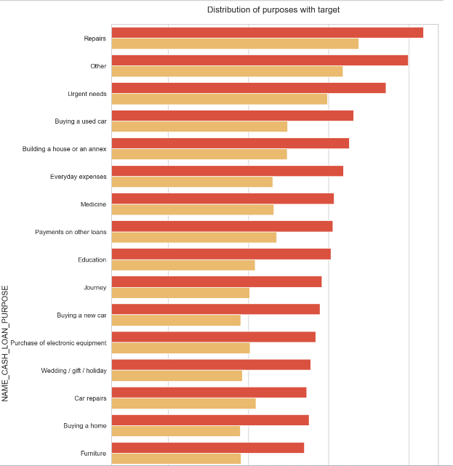

Distribution of Purpose with Target

Slide 37
Points to be concluded from the graph:
Loan purposes with 'Repairs' are facing more difficulties in payment on time.
There are few places where loan payment is significantly higher than facing difficulties. They are 'Buying a garage', 'Business development', 'Buying land’, 'Buying a new car’, and 'Education' Hence we can focus on these purposes for which the client is having minimal payment difficulties.

Slide 38
Performing Bivariate Analysis for Previous Data

Slide 39
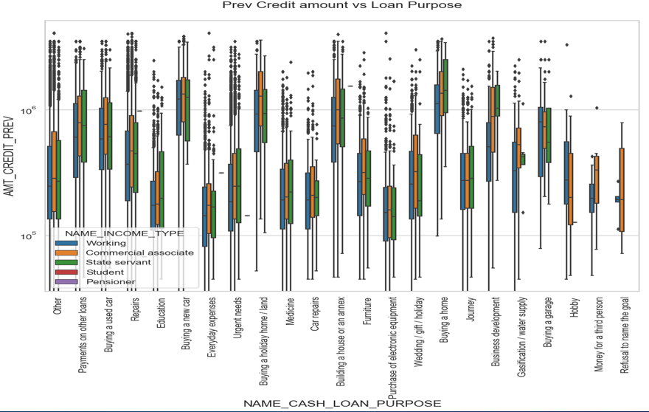
Previous Credit Amount Vs Loan Purpose

Slide 40
Points to be concluded from the graph:
The credit amount for Loan purposes like 'Buying a home’, ’Buying land’, 'Buying a new car’, and ‘Building a house' is higher.
Income type of state servants have a significant amount of credit applied
Money for the third person or a Hobby is having fewer credits applied for.

Slide 41
Conclusion
Banks should focus more on contract types ‘Student’,’ pensioner’, and ‘Businessman’ with housing ‘types other than ‘Co-op apartment’ for successful payments.
Banks should focus less on income type ‘Working’ as they are having the most number of unsuccessful payments.
Also with loan purposes ‘Repair’ is having a higher number of unsuccessful payments on time.
Get as many as clients from the housing type ‘With parents’ as they are having the least number of unsuccessful payments.

